Slide 1
Coding & Marking in the Meat Processing industry
Linx Printing Technologies Ltd.

Slide 2
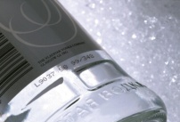
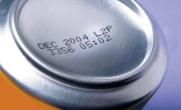
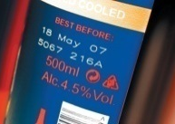
Overview
The Meat Processing industry
Keeping up with legislation
Coding on a Meat Processing line
Technologies used in the industry

Slide 3
The Meat Processing industry
Hugely important industry, employing over 100,000 people in abattoirs, meat processing and manufacturing plants
The horsemeat scandal, and other factors like lower consumption levels of red meat, have meant that industry revenue is set to decrease by 6% over the current year according to IBIS World
46 of the UK’s leading processors are in financial difficulty according to Plimsoll

Slide 4
Keeping up with legislation
Packers require a flexible coding solution in order to meet new legislative challenges:
New Food Information for Consumers Regulation (FIR) brings in EU rules to consolidate existing labelling, replaces current UK law after three years
Origin requirements tightened and extended to fresh and frozen meats of various species, showing information on place of rearing and slaughter

Slide 5
Coding on a Meat Processing line
There are a number of things to think about when coding
meat products, however the key factors are:
Code content
Substrate
Coding environment

Slide 6
Coding on a Meat Processing line
The challenge of content:
Future food labelling legislation means an element of uncertainty as to the continued simplicity of codes
Will increased complexity mean additional lines, smaller print areas, or even different orientations?
The solution:
Digital coders can enable you to code at many different angles - from the top side, or bottom – even traversing the production line if necessary
Coders are also flexible, being able to switch between different packs and code type easily

Slide 7
Coding on a Meat Processing line
The substrates challenge:
There are a wide range of materials used in the meat processing industry, including rigid or flexible plastic containers, coated card, or just cardboard
Smudging codes can result in wasted product, as some items are perishable and cannot be recoded
The solution:
Specialist quick drying inks are developed specifically to ensure codes do not rub off, even when moisture is present
These inks also ensure that codes will stay put whatever the substrate
Printers are easy to use, and can switch between multiple products quickly and easily, while still maintaining code integrity

Slide 8
Coding on a Meat Processing line
The coding environment challenge:
Meat processing lines have stringent hygiene guidelines, meaning that machines have to undergo regular caustic washdowns
Wet or cold conditions can effect code integrity
The solution:
Printers are made with IP rated stainless steel casings to prevent against rust, and ensure important components are not damaged during washdowns – avoiding unwanted downtime
Fast drying inks ensure that code integrity is maintained. Codes will not rub off, meaning less wasted product

Slide 9
Coding technologies used in Meat Processing
Many meat processing plants use analogue printers on their products currently – a cheaper machine, but not necessarily cost effective:
These include printers such as roller coders or hot stamp printers:
Based on a printer roll system, so not much flexibility when it comes to changing code size or length
Product changeovers can be slow also
Worn printer rolls could also deliver unreliable codes, leading to waste
Slower, contact solution – could potentially be less hygienic

Slide 10
Digital coding technologies
Continuous Ink Jet
Can print on any substrate
Wide range of inks for any colour substrate, food grade available
High speed, up to 2,600 characters per second
Versatility when placing the printhead, even able to traverse production lines
Quick to install and set up
Large Character Marking
Well suited for printing onto secondary packaging e.g. Cardboard boxes, especially where larger text and graphics are required
Can print high resolution quality
Easy to set up and adjust
Reliable and predictable cost of ownership

Slide 11
Digital coding technologies
Laser
No ink, and therefore no drying time or risk of smudging
Suitable for a wide range of substrates
Low down time
High-speed capability
Thermal Inkjet Printers
Flexible coding for both outer cases and primary packaging
High resolution print quality
Cost effective for slower production lines

Slide 12
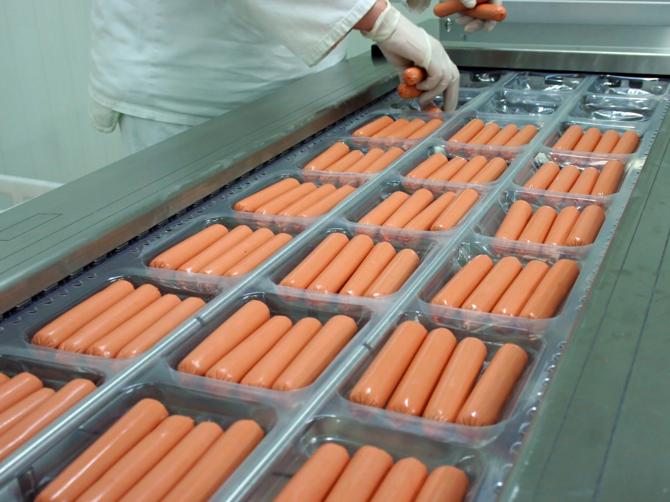
Find Out More
linx.co.uk/meat

